Slide 1
MY SQL [Structural Querry Language]

Slide 2
Structural Query Language
MySQL is the most popular open source relational database management system.
MySQL used for developing various web based software development.
Developed by company MySQL AB. (Based on CNC++)

Slide 3
Types of My SQL Servers
Oracle server
Mango DB Server
MY SQL Workbench
Navigation
No SQL Server
Post Grade SQL
MS Server

Slide 4
System Types
DBMS System
Database Management Systems (DBMS) are software systems used to store, retrieve, and run queries on data.
RDBMS System
A relational database management system (RDBMS) is a program
Used to create,update and manage relationam database.

Slide 5
SQL Statements
DDL [Data definition Language ]
DML [Data Manupulation Language ]
DQL [Data Querry Language ]
TCL [Transaction Control Language ]
DCL [Data Control Language ]

Slide 6
DDL(Data Defenition Language)
That describes the portion of SQL that creates, alters, and deletes database objects. These database objects include schemas, tables, views, sequences, catalogs, indexes, variables, masks, permissions, and aliases.
Databae Creation
Table Creation
Alter Table
Add New Column

Slide 7
DML(Data Manupulation Language
It is a class of SQL statements that are used to query, edit, add and delete row-level data from database tables or views. The main DML statements are SELECT , INSERT , DELETE , and Update.
Insert Values
Update Values
Delete Values

Slide 8
DQL(Data Query Language)
It is a component of the SQL statement that allows getting data from the database and imposing order upon it. It includes the SELECT statement. This command allows getting the data out of the database to perform operations with it.

Slide 9
DQL(Data Query Language)
General Functions
Where
And
IN
Not In
LessThan
GreaterThan
Like
Not Like
Count
Group By
Order By

Slide 10
Calculated Functions(Aggregate Function)
Sum
Average
Minimum
Maximum
Count If
String Function
Upper Case
Lower Case
Trim
Left,Right
Concadenate
Length

Slide 11
Logical Functions
If Condition
If With
If With Or
Nested If
Null If
Is Null

Slide 12
Number Functions
Round
Char Length
Coiling
Floor
Sign
Squart

Slide 13
Date Time Functions
Date Add
Date Sub
Timestampdiff
Year
Month
Date
Date Format

Slide 14
TCL(Transaction Control Language
It is a set of commands Some examples of TCL commands are ROLLBACK, COMMIT, and SAVEPOINT.
Commit (Save Point)
Rollback (Undo Changes)

Slide 15
Alter Commands
Single Column Add
Multiple Column Add
Add Primary Key
Drop Primary Key
Modify
After Key

Slide 16
Project 1[Loan Management System]
Data set
customer income status
loan status
customer info
country state
region info

Slide 17
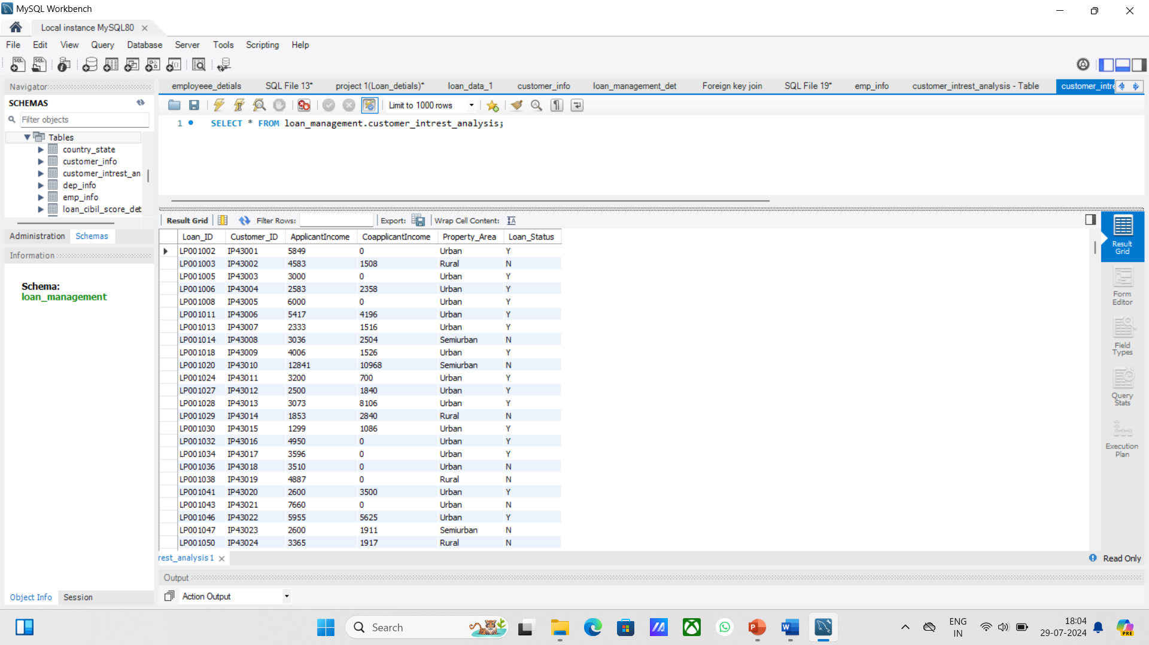
Sheet 1 Import Table From Sheet 1- Customer Income Status

Slide 18
set customer criteria based on applicant income
Criteria :
Applicant income >15,000 = grade a
Applicant income >9,000 = grade b
Applicant income >5000 = middle class customer
Otherwise low class

Slide 19
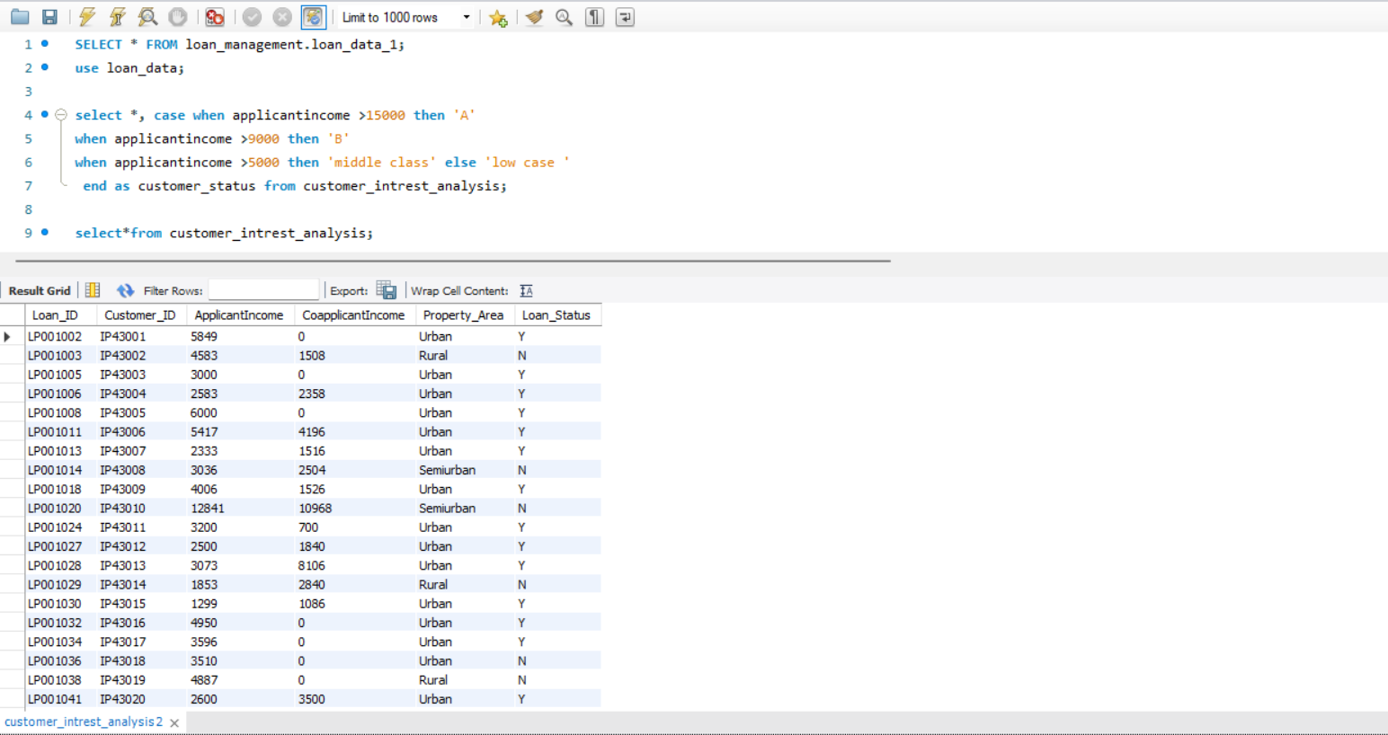

Slide 20
Monthly interest percentage
Criteria
Applicant income <5000 rural=3%
Applicant income <5000 semi rural=3.5%
Applicant income <5000 urban=5%
Applicant income <5000 semi urban= 2.5%
Otherwise =7%

Slide 21
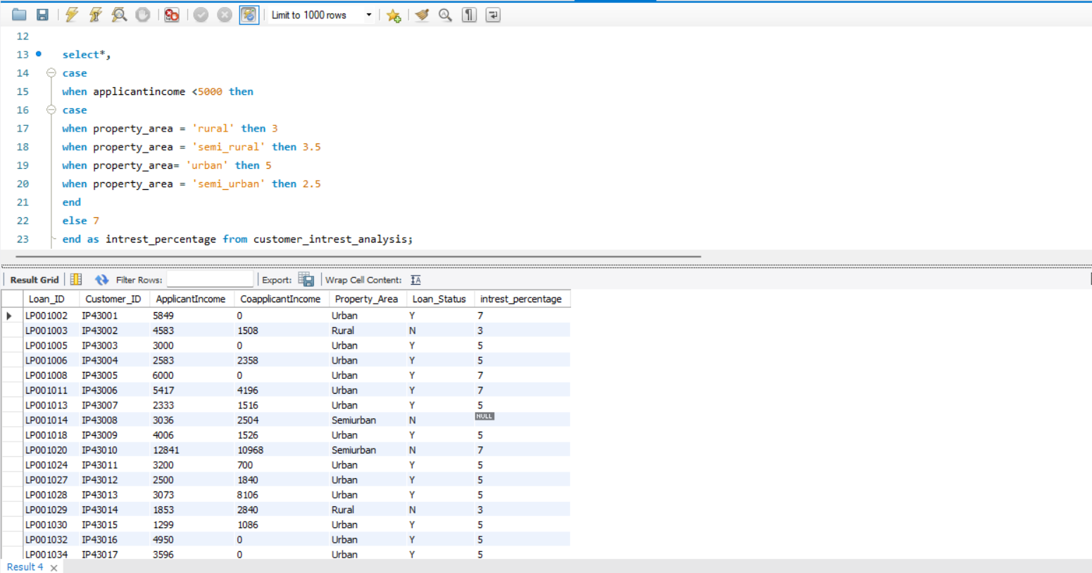

Slide 22
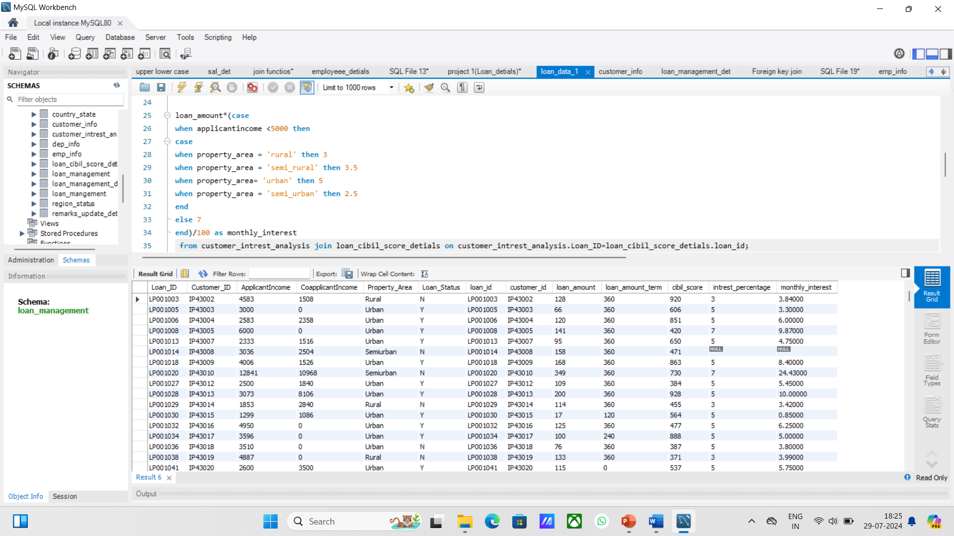
New field creation based on interest
Calculate monthly interest amt and annual interest amt

Slide 23
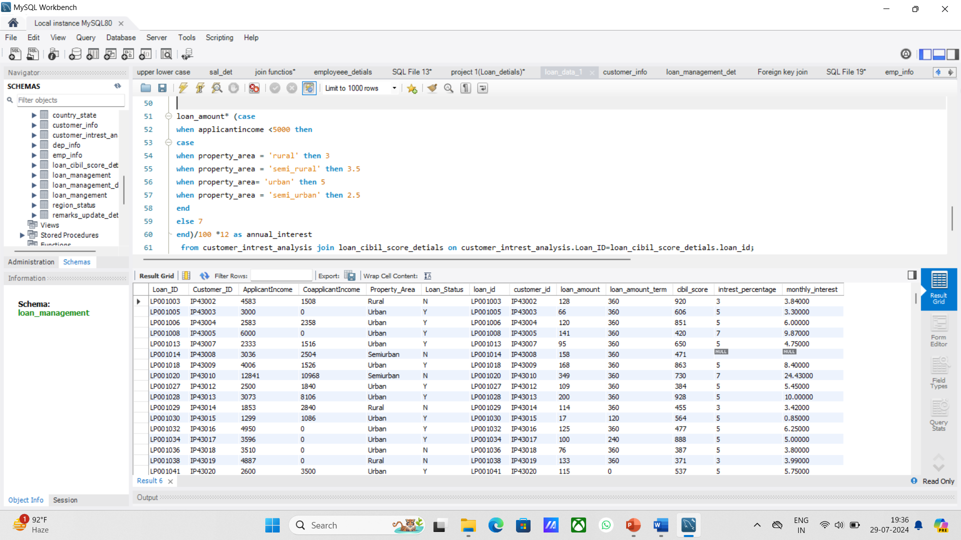
Annual Intrest Amount

Slide 24
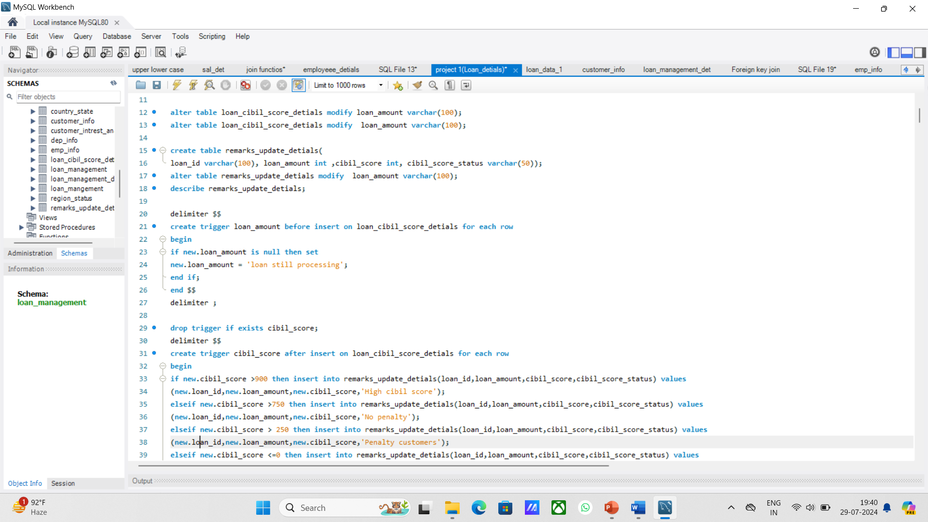
Sheet 2 - loan status
Create row level trigger for loan amt

Slide 25
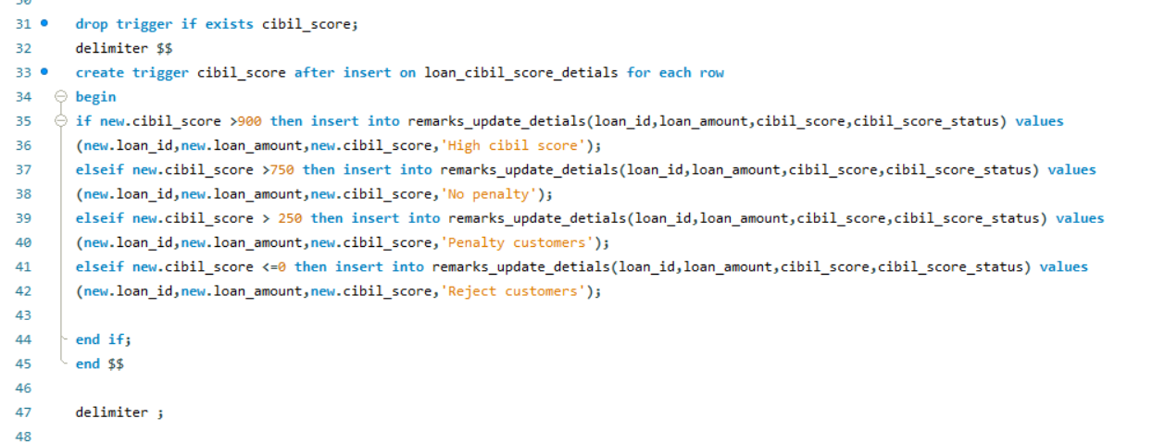
Criteria
Create statement level trigger for cibil score

Slide 26
Criteria
Cibil score >900 high cibil score
Cibil score >750 no penalty
Cibil score >250 penalty customers
Cibil score <=0 reject customers (loan cannot apply)

Slide 27
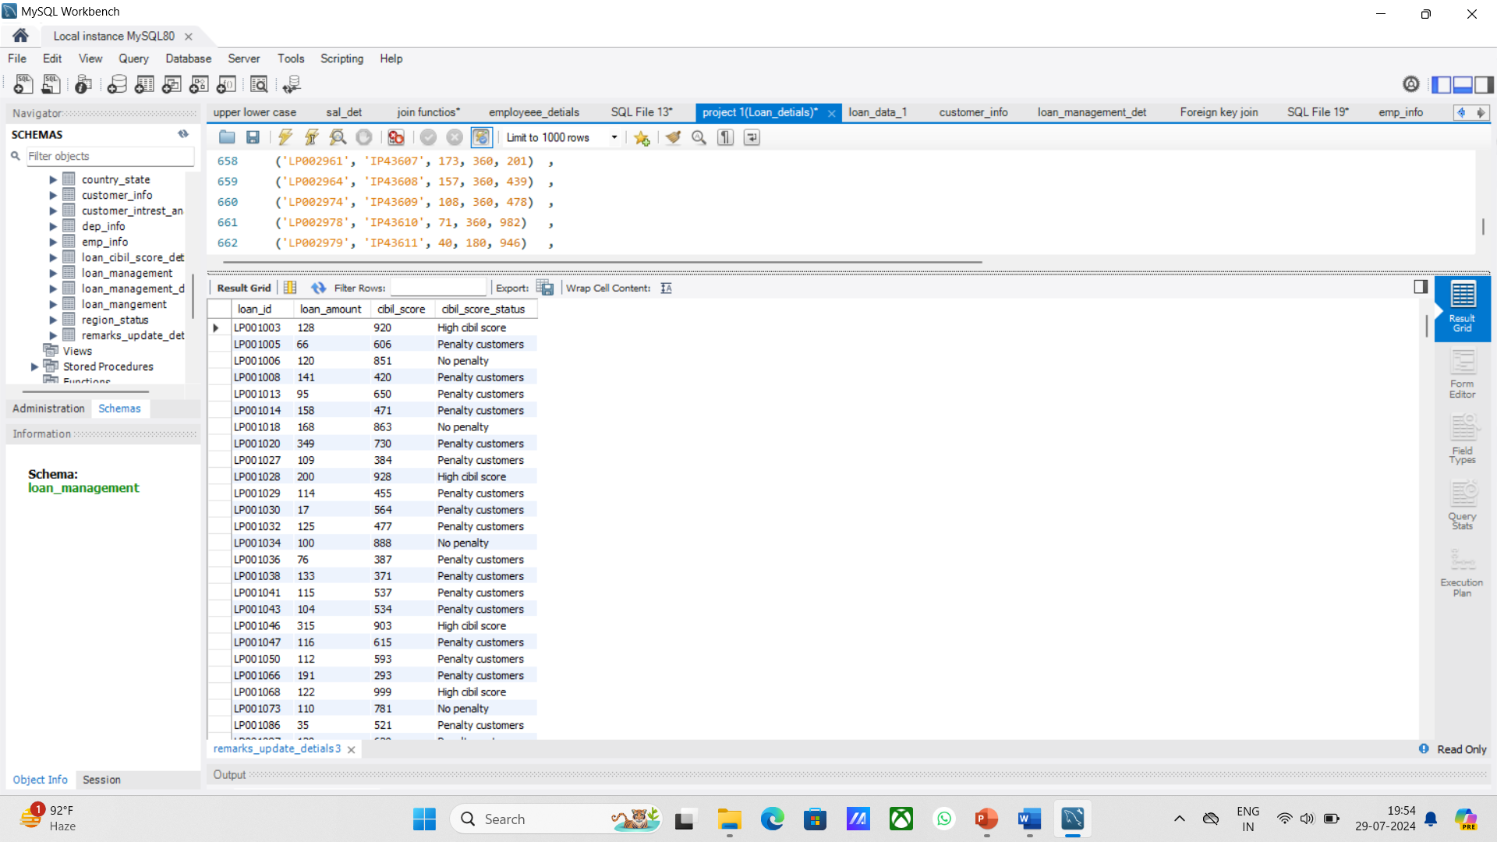

Slide 28
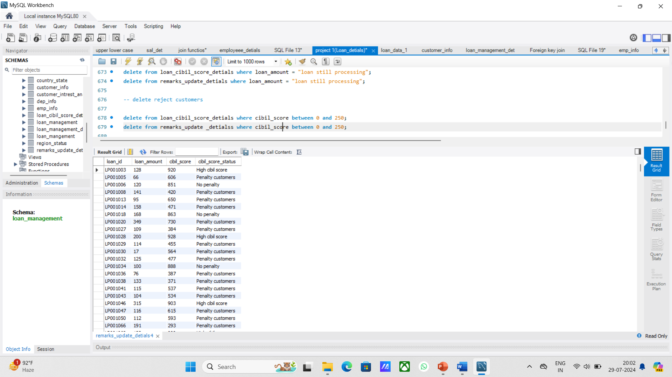
Then delete the reject and loan still processing customers

Slide 29
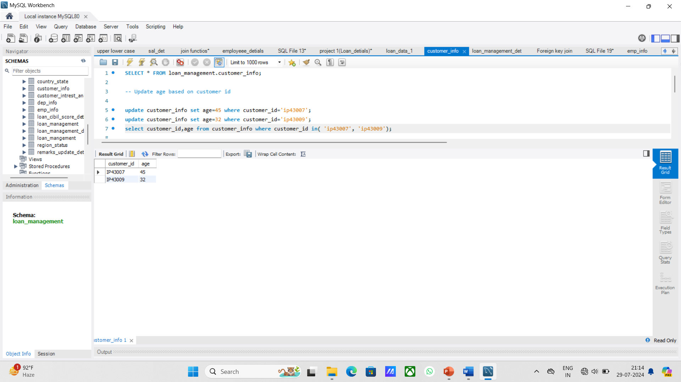
Sheet 3 - customer info
Import the table
Update age based on customer id

Slide 30
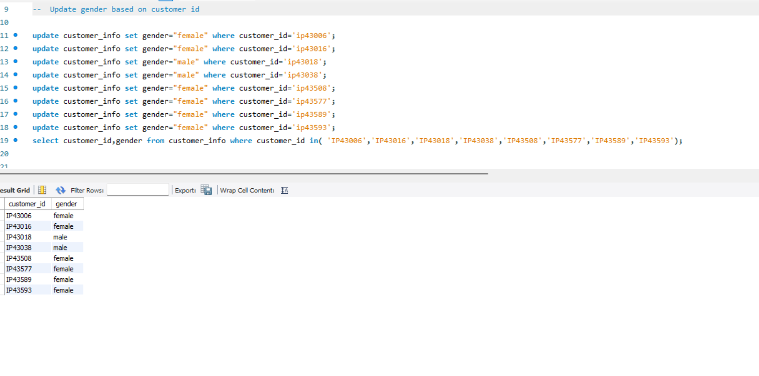
Update Gender Based On Customer_id

Slide 31
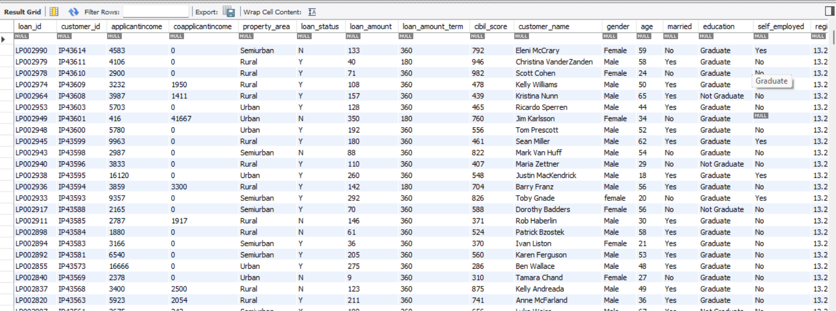
Sheet 4 and 5- country state and region
Join all the 5 tables without repeating the fields - output 1 *find the mismatch details using joins

Slide 32
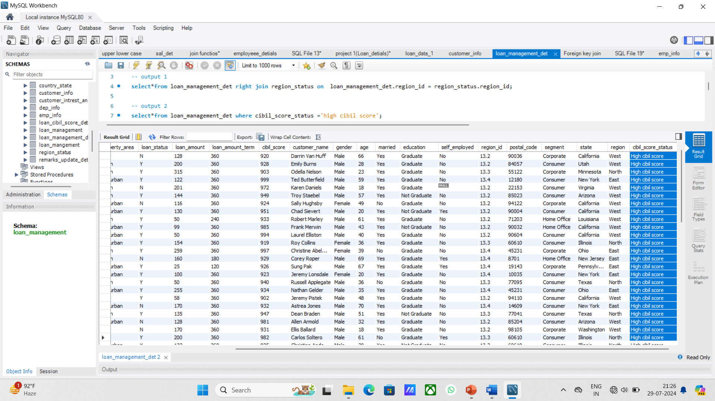
Filtering information using inner join
Filter high cibil scor :

Slide 33
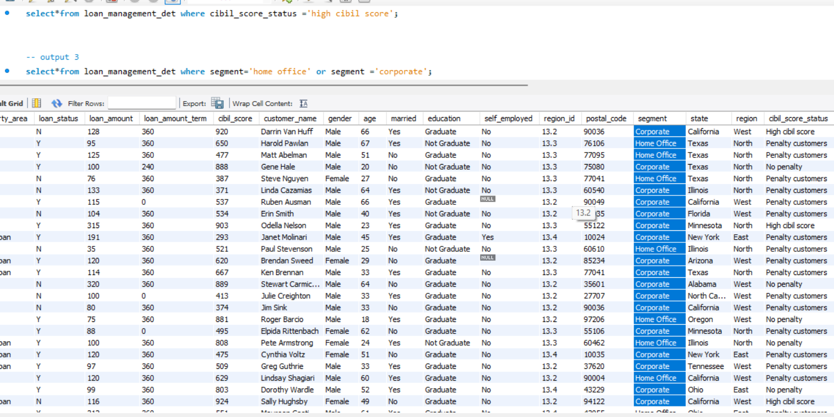
Filter home office and corporate

Slide 34
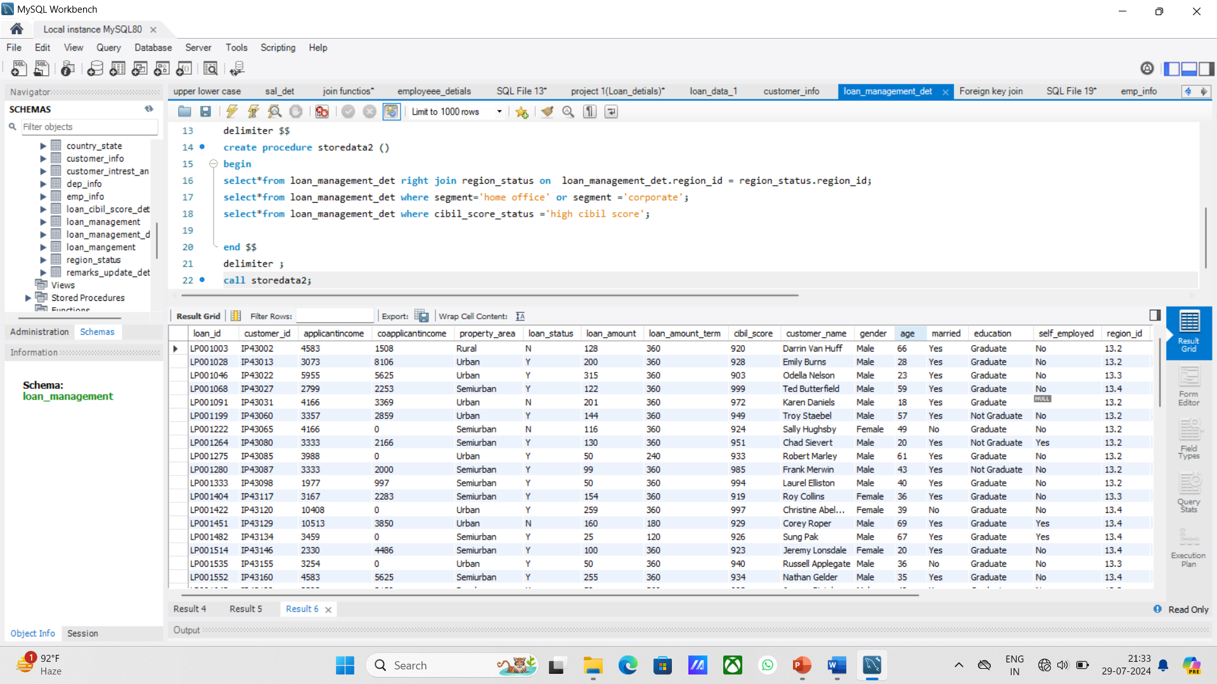
Store all the outputs as procedure

Slide 35
The End

